Slide 1




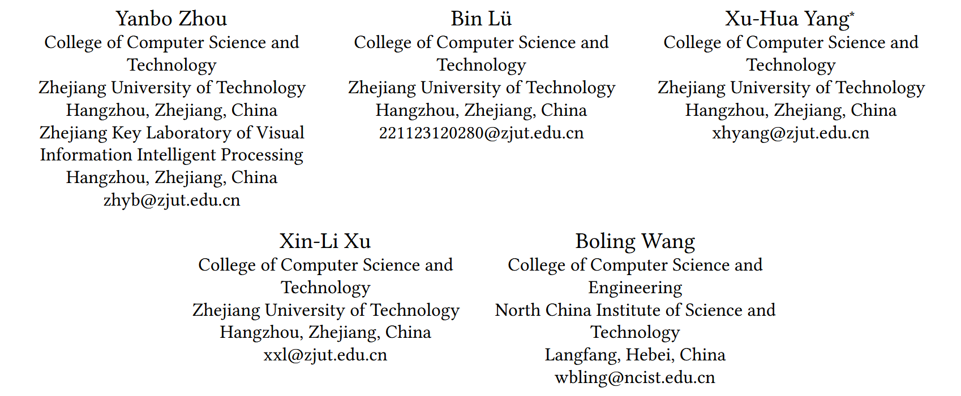





ATAI
Advanced Technique of Artificial Intelligence
ATAI
ChongqingUniversity _{AdvancedTechniqueof}
of Technology Artificial Intelligence
Chongqing University of
Technology
Chongqing University ^{ATAI}
_{of Technology} Advanced Techniqueof
Artificial Intelligence
Chongqing University of Technology
Chongqing University of Technology
Adaptive Contrastive Learning in Sequential Recommendation based on Perturbation and Restoration Networks
Code: https://github.com/xiaomizhou778/ACLSRec.
—WWW 2026
Reported by Cong Sheng
1

Slide 2
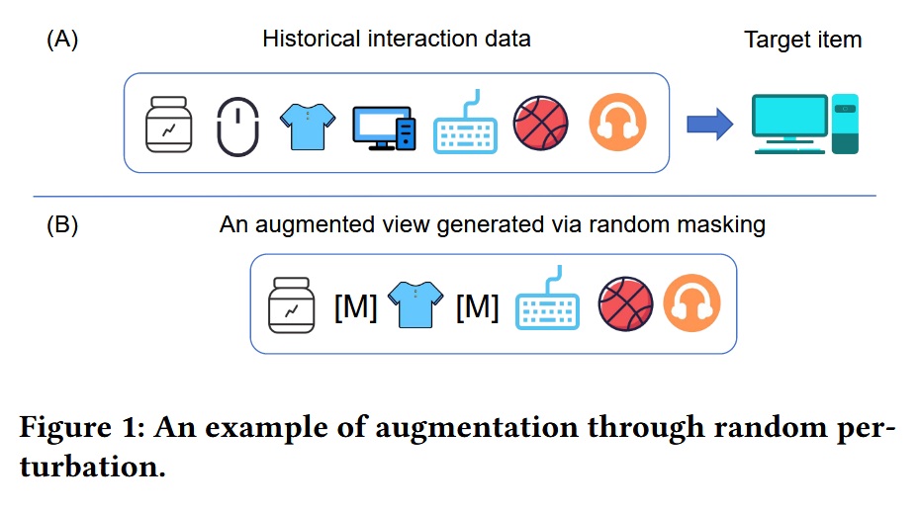
ATAI
Advanced Technique of Artificial Intelligence
ATAI
ChongqingUniversity _{AdvancedTechniqueof}
of Technology Artificial Intelligence
Chongqing University of
Technology
Chongqing University ^{ATAI}
_{of Technology} Advanced Techniqueof
Artificial Intelligence
Chongqing University of Technology
Chongqing University of Technology
Motivation
1) Predefined augmentations may break semantic consistency:
Existing contrastive learning methods usually rely on handcrafted augmentations such as random cropping, masking, reordering, or dropout. However, these operations may remove or corrupt key interactions, causing augmented views to deviate from the user’s true intent.
2) Existing augmentations are coarse-grained and lack adaptive controllability:
Most previous methods generate augmented views by directly modifying user sequences or applying random model-level perturbations, which are not sufficiently fine-grained or semantically controllable. This motivates adaptive augmentation in the latent space through learnable perturbation and restoration networks.

Slide 3
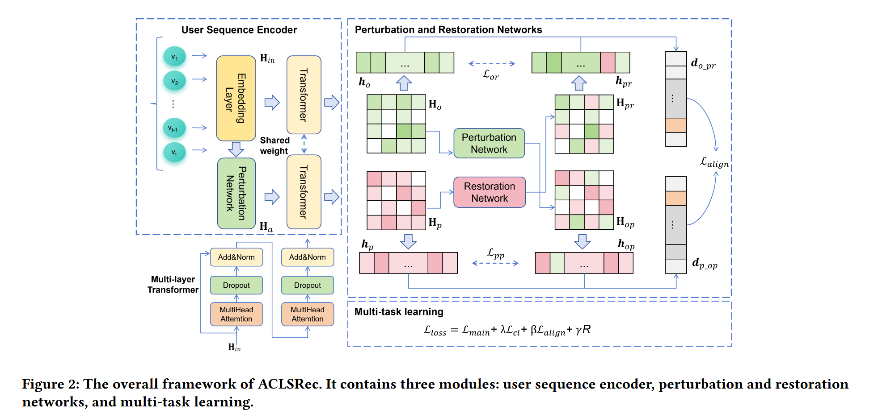
ATAI
Advanced Technique of Artificial Intelligence
ATAI
ChongqingUniversity _{AdvancedTechniqueof}
of Technology Artificial Intelligence
Chongqing University of
Technology
Chongqing University ^{ATAI}
_{of Technology} Advanced Techniqueof
Artificial Intelligence
Chongqing University of Technology
Chongqing University of Technology
Overview

Slide 4
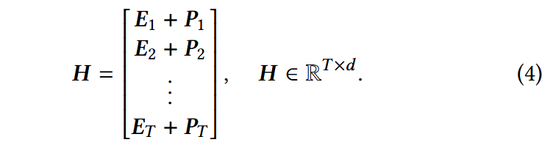



ATAI
Advanced Technique of Artificial Intelligence
ATAI
ChongqingUniversity _{AdvancedTechniqueof}
of Technology Artificial Intelligence
Chongqing University of
Technology
Chongqing University ^{ATAI}
_{of Technology} Advanced Techniqueof
Artificial Intelligence
Chongqing University of Technology
Chongqing University of Technology
Method

Slide 5
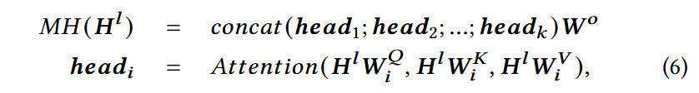
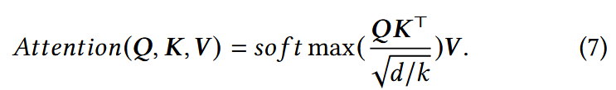


ATAI
Advanced Technique of Artificial Intelligence
ATAI
ChongqingUniversity _{AdvancedTechniqueof}
of Technology Artificial Intelligence
Chongqing University of
Technology
Chongqing University ^{ATAI}
_{of Technology} Advanced Techniqueof
Artificial Intelligence
Chongqing University of Technology
Chongqing University of Technology
Method

Slide 6






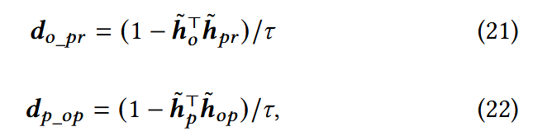

ATAI
Advanced Technique of Artificial Intelligence
ATAI
ChongqingUniversity _{AdvancedTechniqueof}
of Technology Artificial Intelligence
Chongqing University of
Technology
Chongqing University ^{ATAI}
_{of Technology} Advanced Techniqueof
Artificial Intelligence
Chongqing University of Technology
Chongqing University of Technology
Method

Slide 7
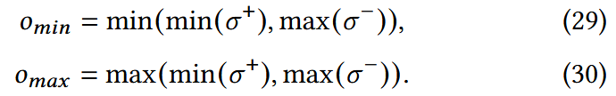

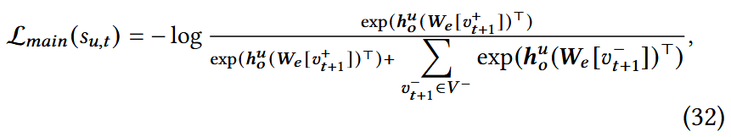
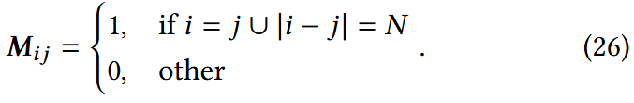
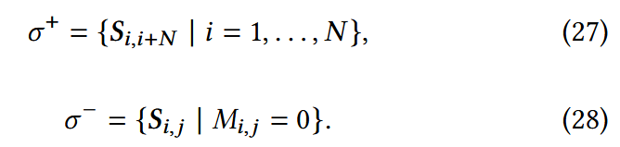
ATAI
Advanced Technique of Artificial Intelligence
ATAI
ChongqingUniversity _{AdvancedTechniqueof}
of Technology Artificial Intelligence
Chongqing University of
Technology
Chongqing University ^{ATAI}
_{of Technology} Advanced Techniqueof
Artificial Intelligence
Chongqing University of Technology
Chongqing University of Technology
Method

Slide 8
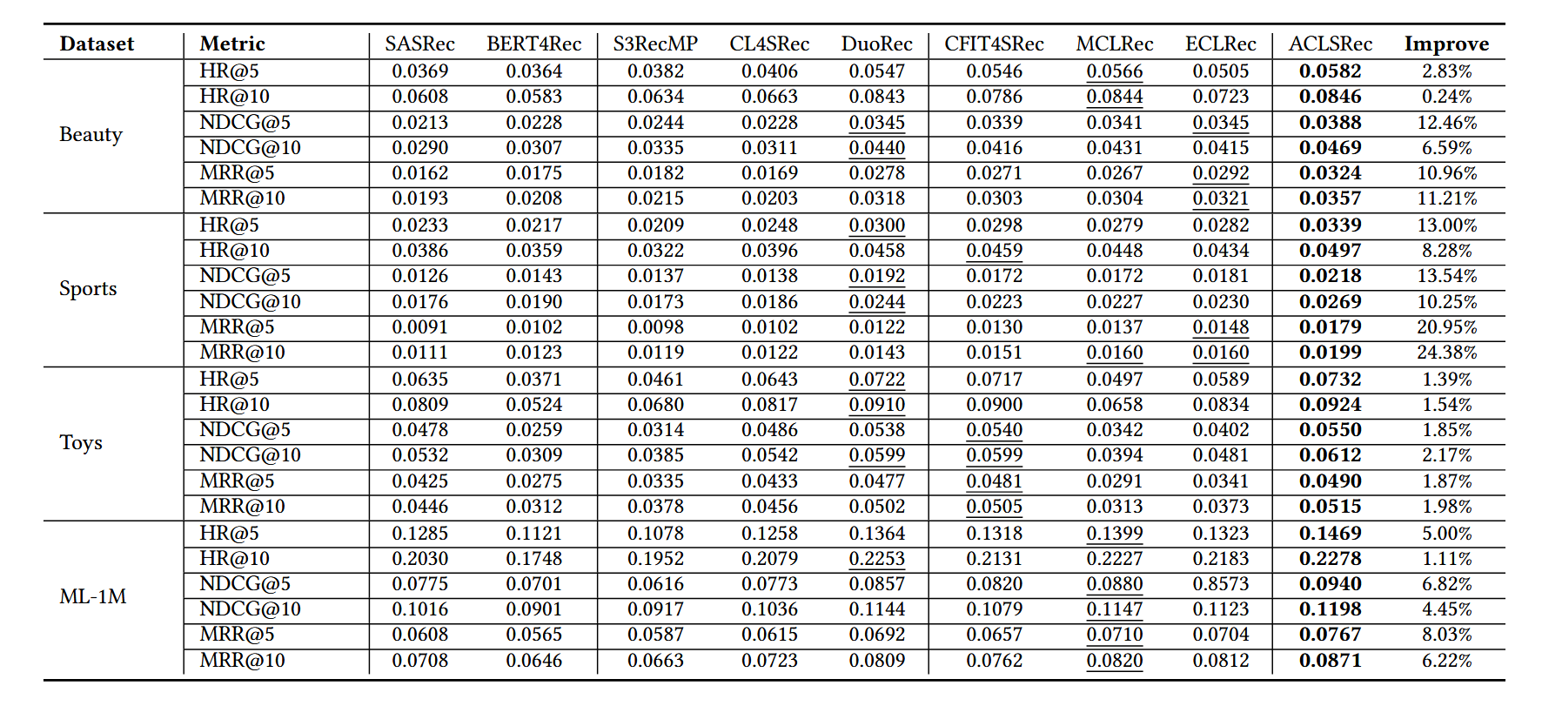
ATAI
Advanced Technique of Artificial Intelligence
ATAI
ChongqingUniversity _{AdvancedTechniqueof}
of Technology Artificial Intelligence
Chongqing University of
Technology
Chongqing University ^{ATAI}
_{of Technology} Advanced Techniqueof
Artificial Intelligence
Chongqing University of Technology
Chongqing University of Technology
Experiments

Slide 9
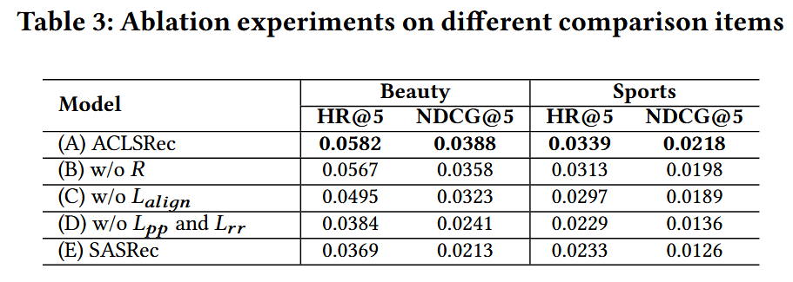
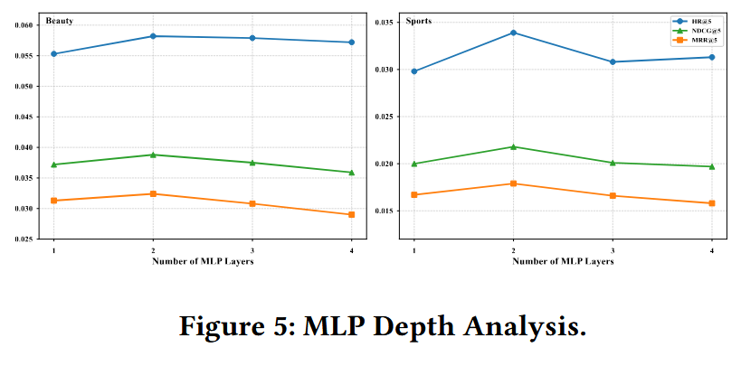
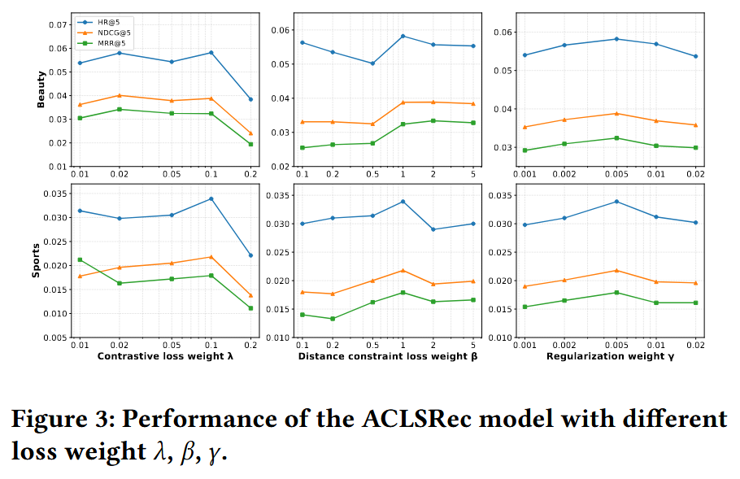
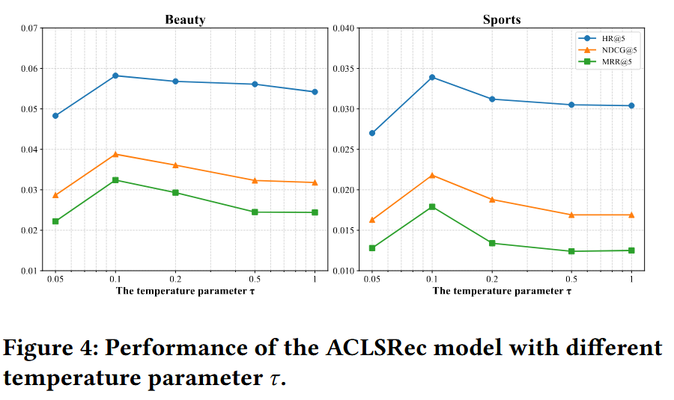
ATAI
Advanced Technique of Artificial Intelligence
ATAI
ChongqingUniversity _{AdvancedTechniqueof}
of Technology Artificial Intelligence
Chongqing University of
Technology
Chongqing University ^{ATAI}
_{of Technology} Advanced Techniqueof
Artificial Intelligence
Chongqing University of Technology
Chongqing University of Technology
Experiments

Slide 10


ATAI
Advanced Technique of Artificial Intelligence
ATAI
ChongqingUniversity _{AdvancedTechniqueof}
of Technology Artificial Intelligence
Chongqing University of
Technology
Chongqing University ^{ATAI}
_{of Technology} Advanced Techniqueof
Artificial Intelligence
Chongqing University of Technology
Chongqing University of Technology
Thanks!

